Slide 1
COVID-19 Testing & monitoring

Slide 2
Covid19 Helpline for Hostel staff /(Triage)
Operates 9 to 9, 7 days a week
1800 90 17 90
Line triages for testing, doing the testing ourselves
Majority of calls: covid related queries from hostel staff about residents
All clinical queries are put through to clinician.
Addiction needs or isolation needs are hot reported

Slide 3
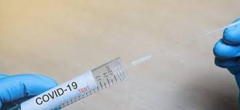
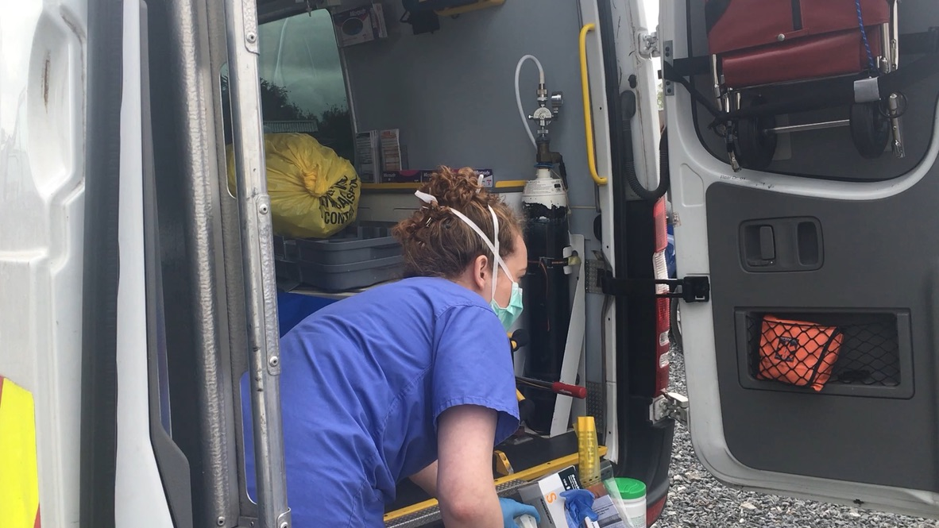
Testing
Safetynet trained in testing and swabbing for (NAS)
Residents access testing service by helpline only;
As of Monday, 231 tests done, awaiting results 25 results
5 x DSC volunteer nurses
implement lower threshold criteria for testing - allows isolation beds to be managed more efficiently
Rapid testing GeneXpert device: detection in 45 minutes. Safetynet prioritise

Slide 4
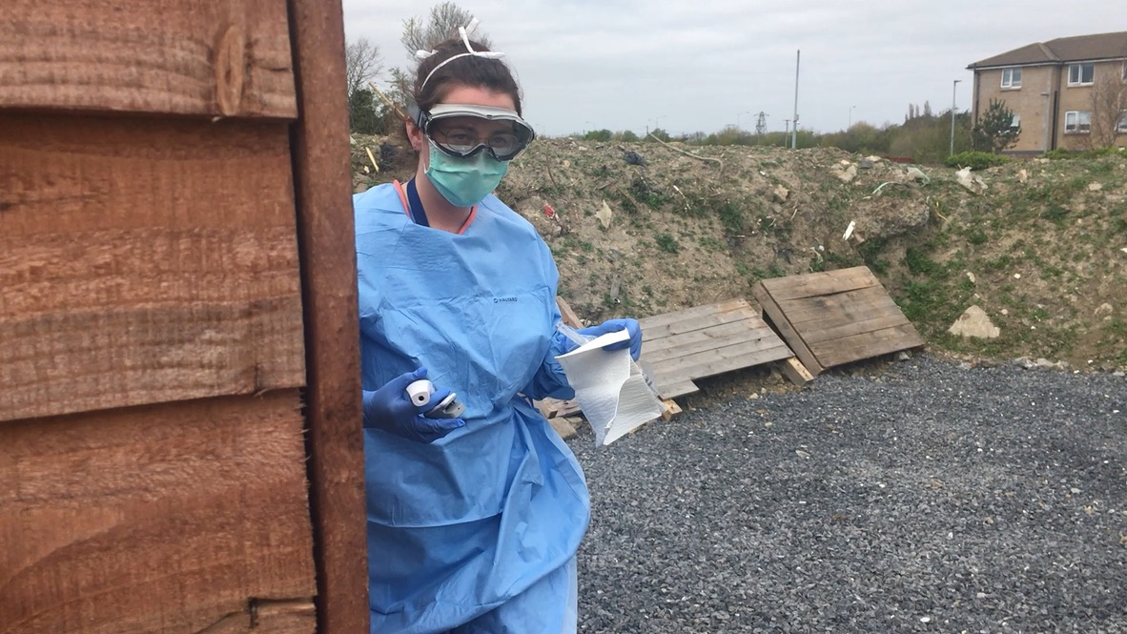
Monitoring & Assessment (M&A)
Testing team give the M&A helpline number (0879351332) to patients when they are getting tested. Patients asked to phone the helpline if they feel worse.
Care plans developed for patients in isolation eg frequency of check-ins etc.
Positive / presumed positive cases given in-person assessment on Mobile health Unit outside patients’ locations
Patients deemed either fit to stay at home or ambulances called;
In-person assessments / phone consultation at isolation sites (State City with PMVT)
High or low risk sheets

Slide 5
Roma
Roma community experience the highest burden of infection
Very high rate in Roma tested (versus community rate)
Safetynet doing pre-emptive screens of Private Emergency Accommodations to identify Roma families living in congregated setting who are unwell.
ROMA Help line – 087 126 4606

